Slide 1

RUNGTA COLLEGE OF DENTAL SCIENCES AND RESEARCH
PULMONARY EMBOLISM
DEPARTMENT OF GENERAL MEDICINE

Slide 2
SPECIFIC LEARNING OBJECTIVES
MUST KNOW | NICE TO KNOW | DESIRE TO KNOW
ETIOLOGY | RISK FACTORS | INCIDENCE
CLINICAL FEATURES | ACUTE MASSIVE PE | PROGNOSIS
MANAGEMENT | ACUTE SMALL PE | CASE STUDY
 | SUBMASSIVE PE
 | INVESTIGATIONS

Slide 3
CONTENTS
INCIDENCE
ETIOLOGY
RISK FACTORS
CLINICAL FEATURES
ACUTE MASSIVE PE
ACUTE SMALL/ MEDIUM PE
SUBMASSIVE PE
INVESTIGATIONS
MANAGEMENT
PROGNOSIS
CASE STUDY
SUMMARY

Slide 4
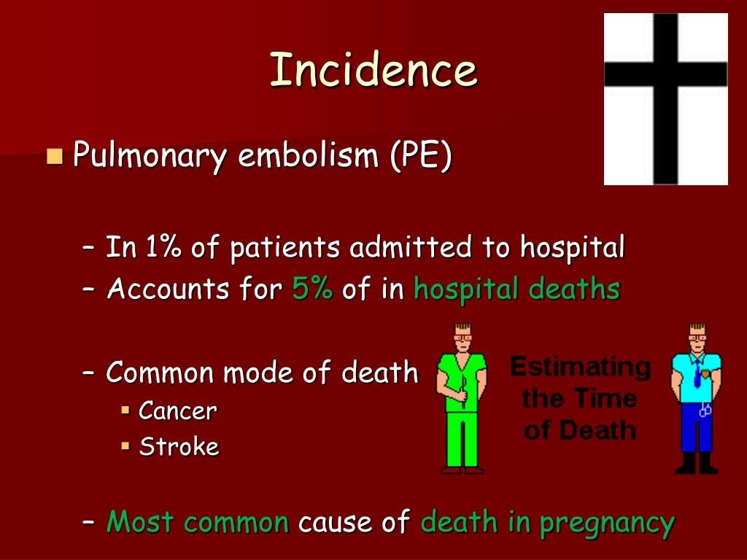

Slide 5
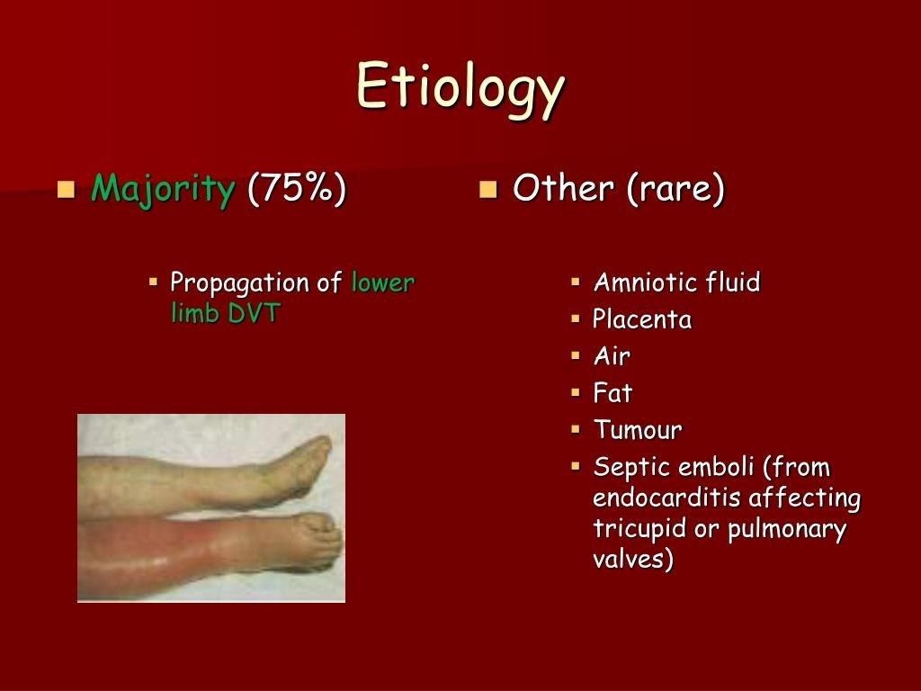

Slide 6
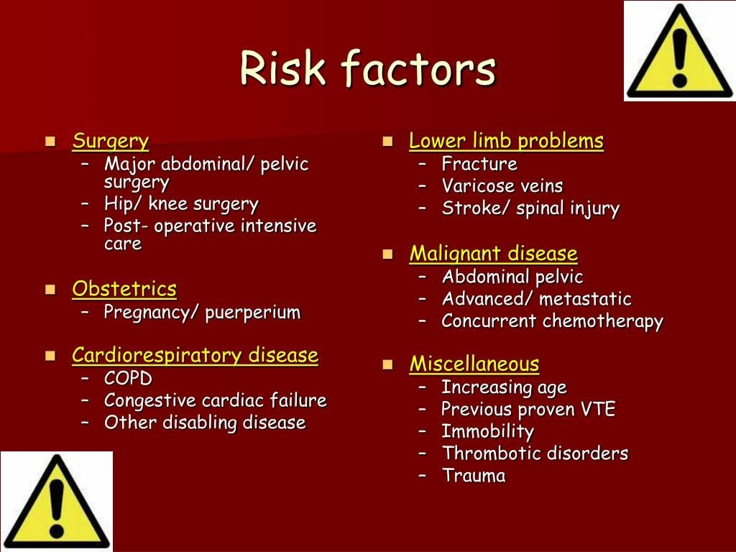

Slide 7
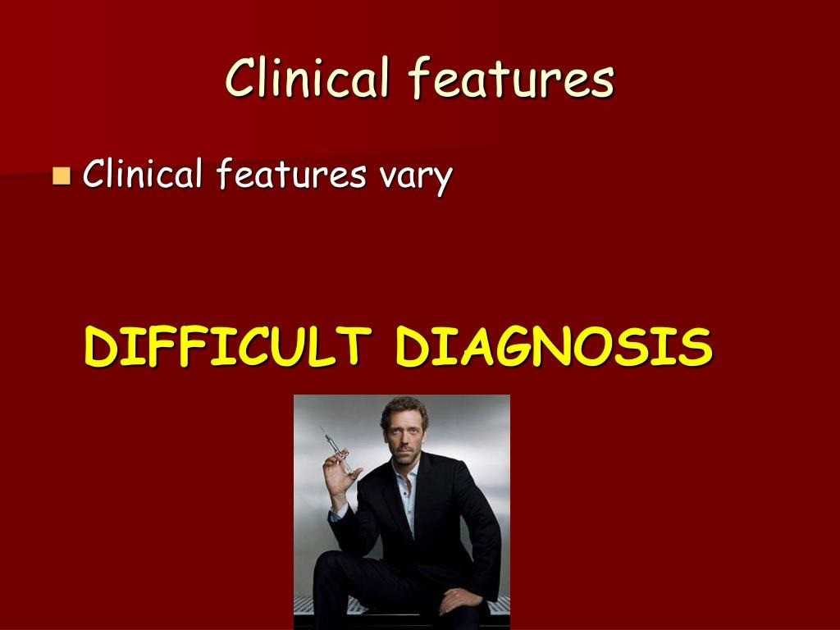

Slide 8
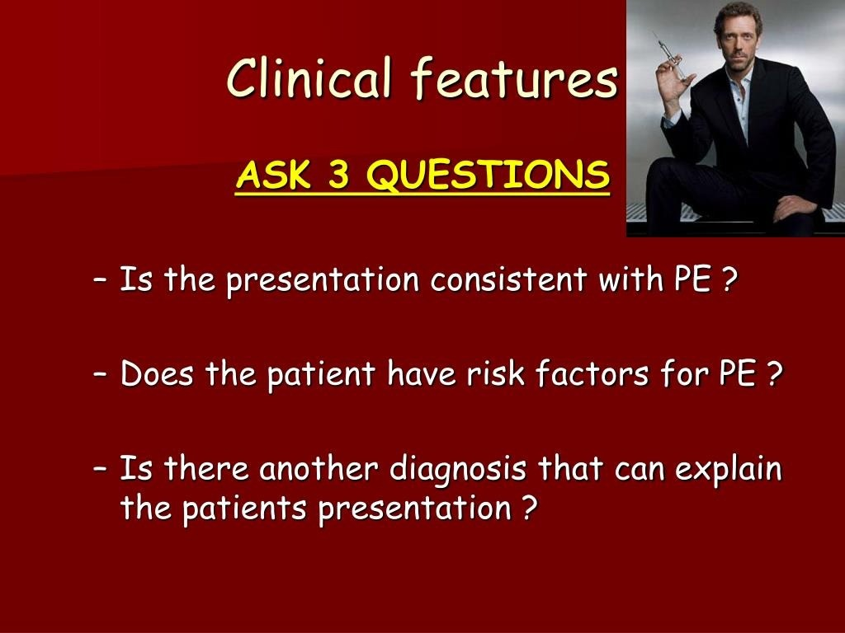

Slide 9
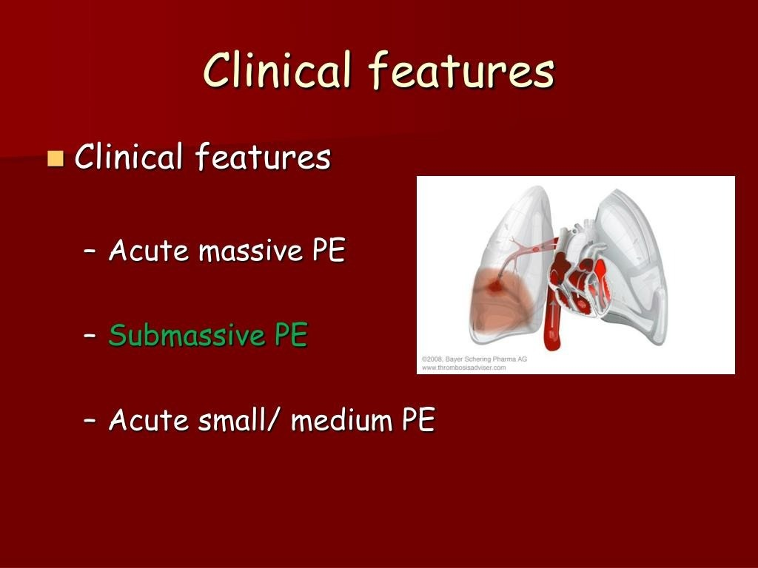

Slide 10
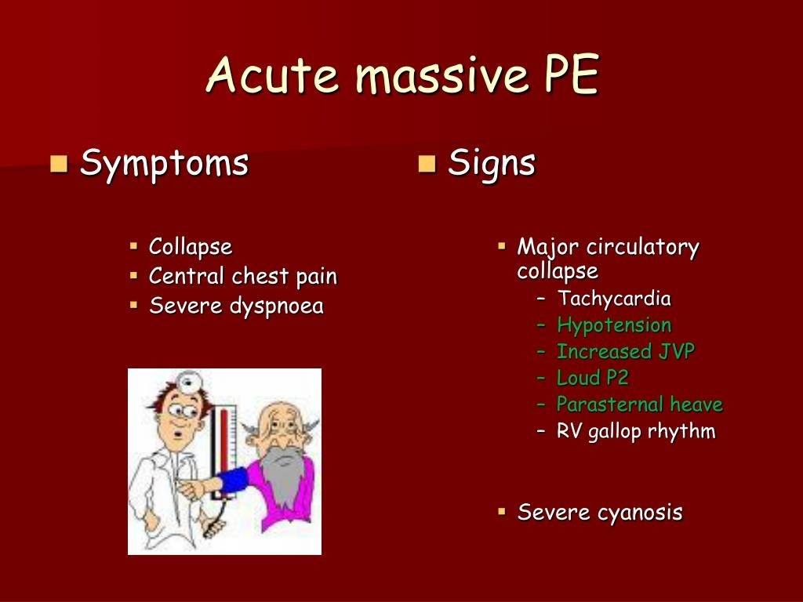

Slide 11
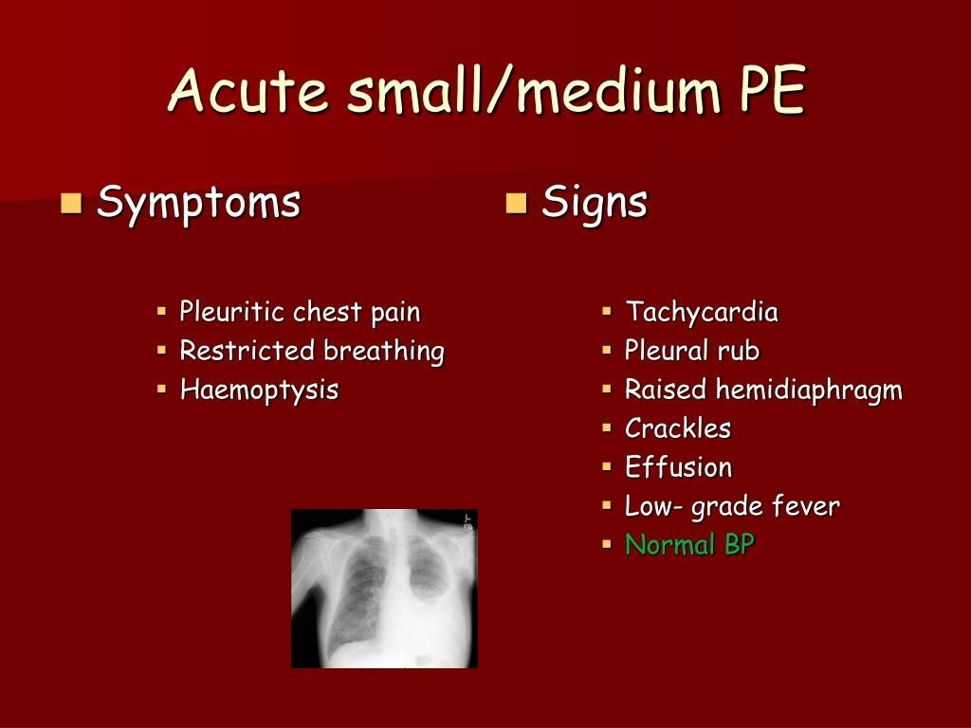

Slide 12


Slide 13
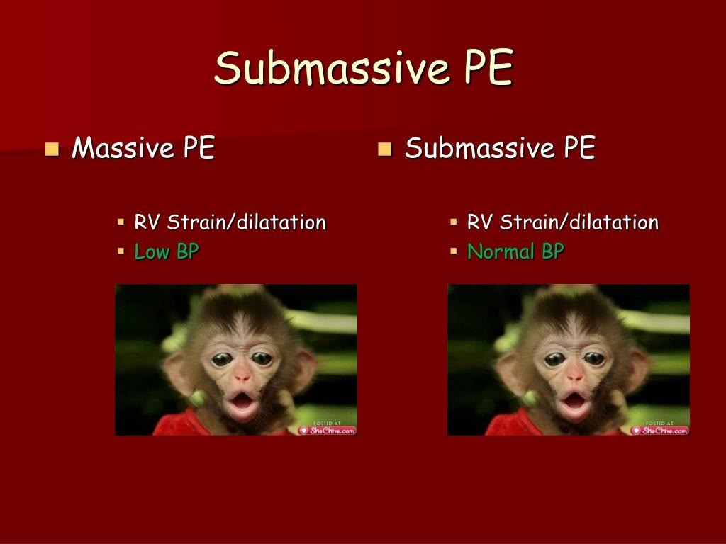

Slide 14
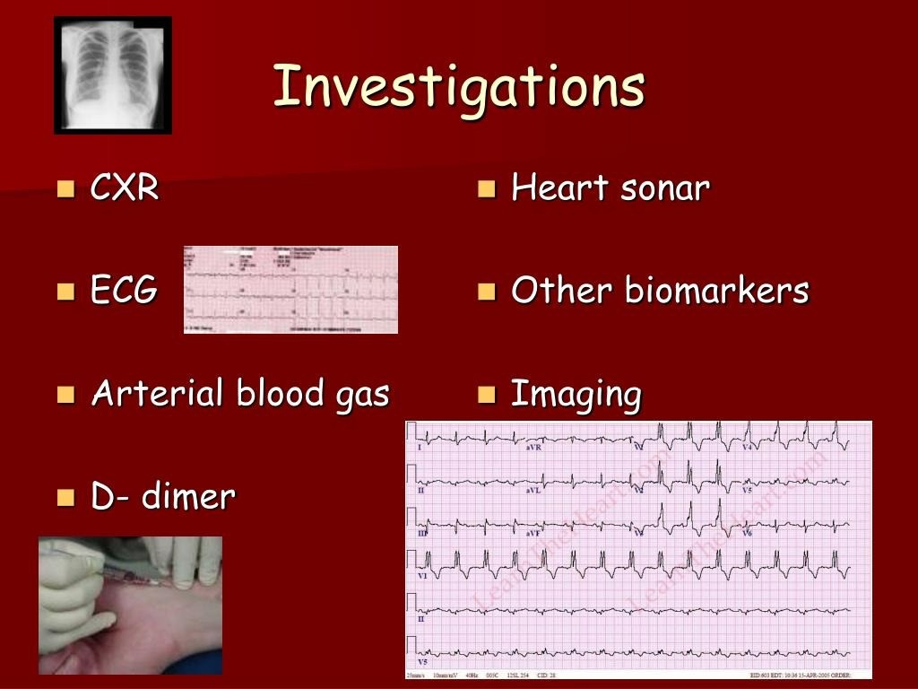

Slide 15
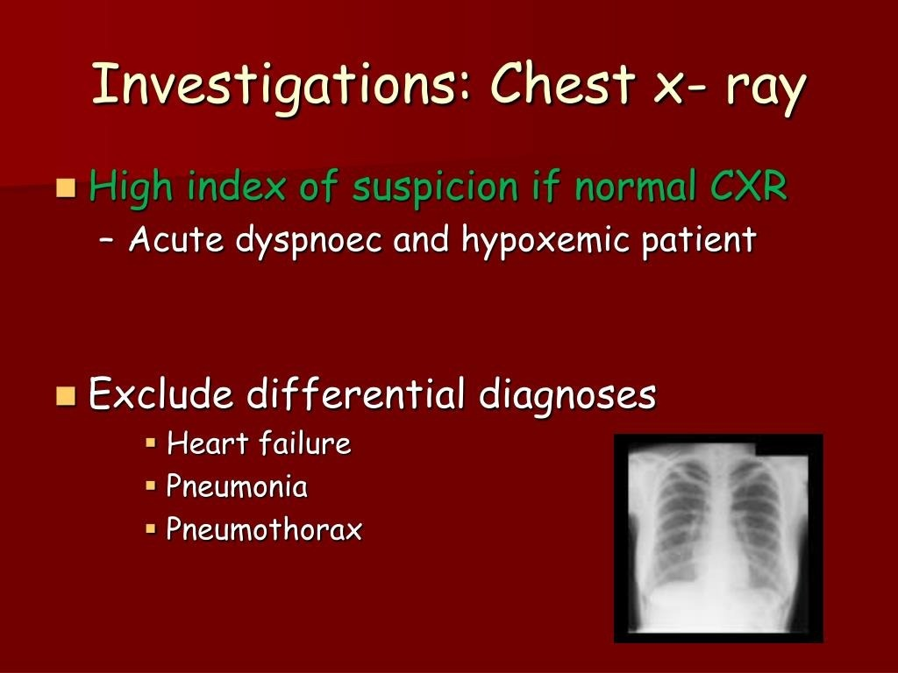

Slide 16
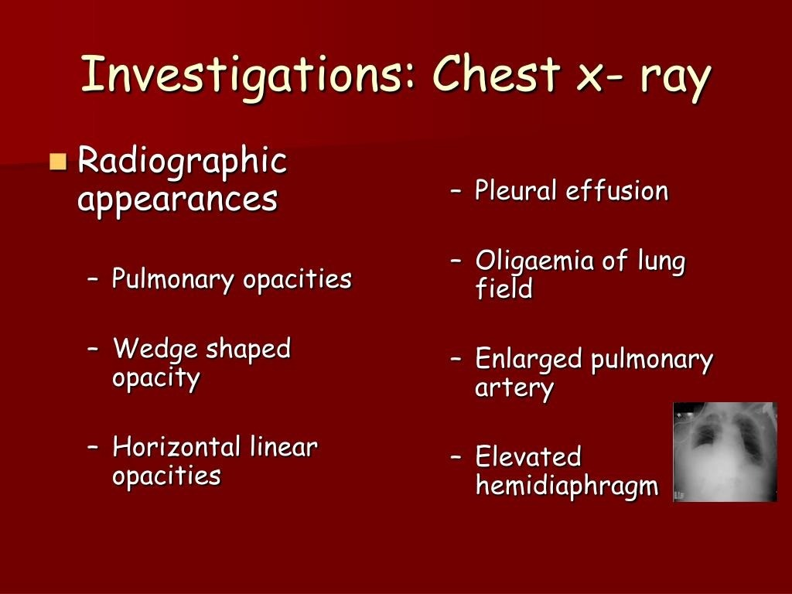

Slide 17
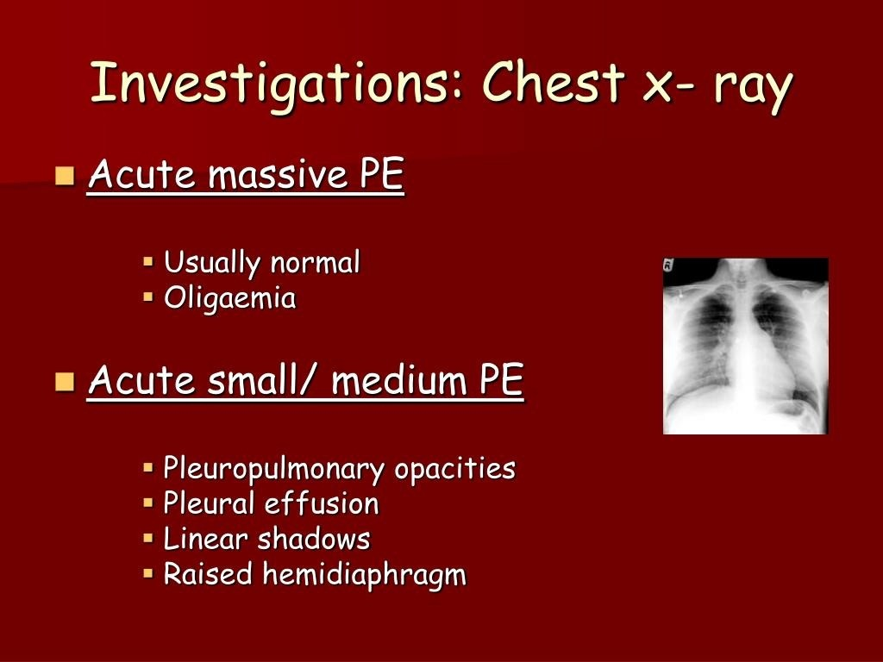

Slide 18
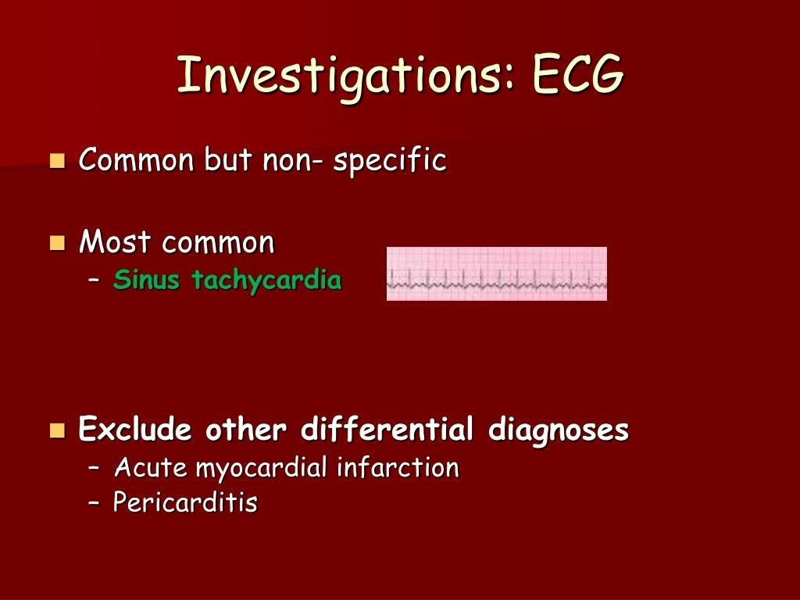

Slide 19
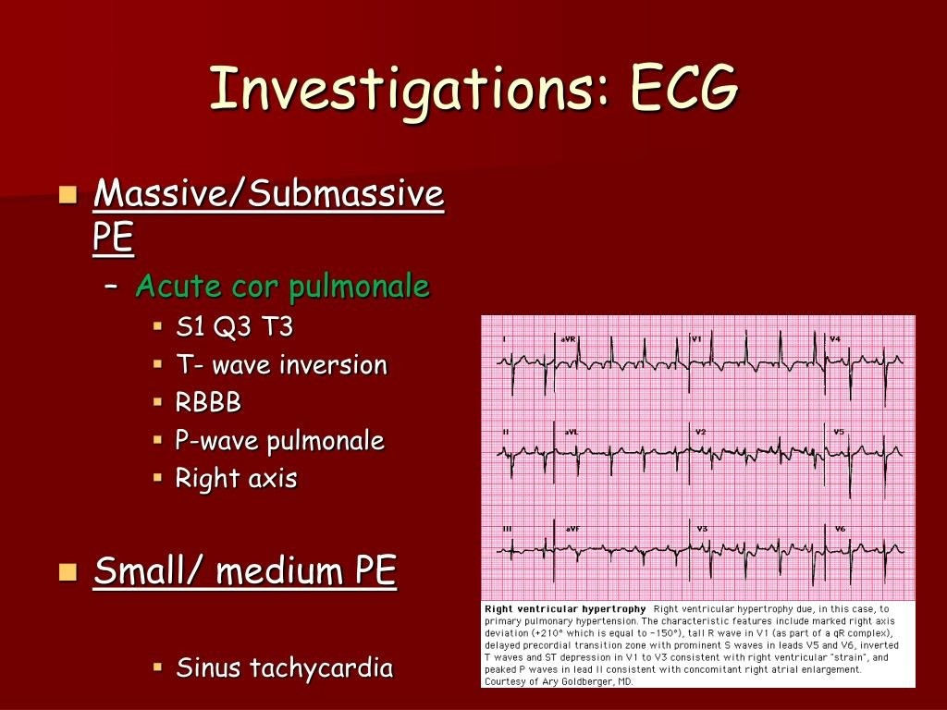

Slide 20
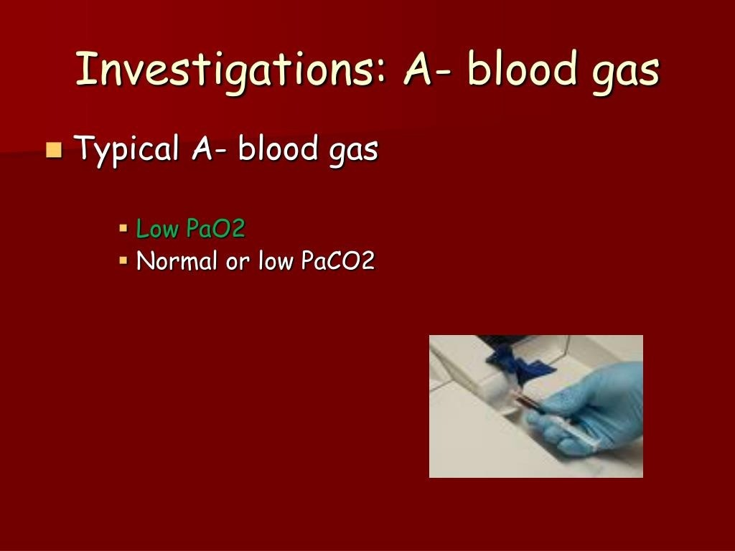

Slide 21
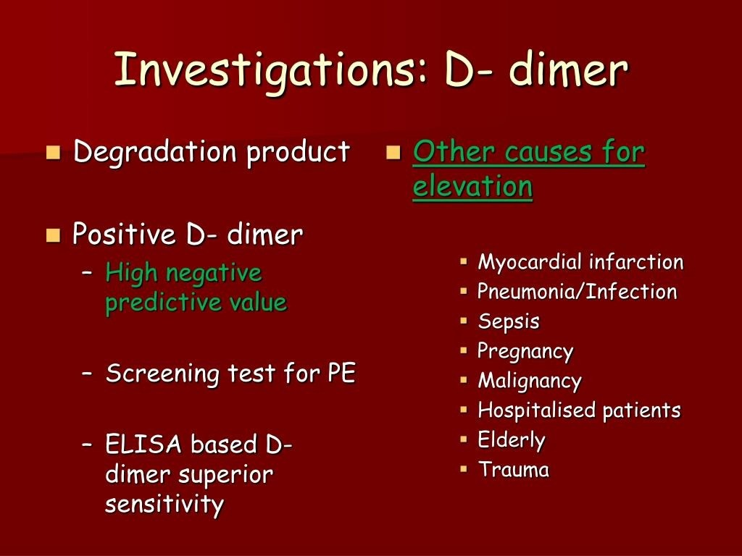

Slide 22
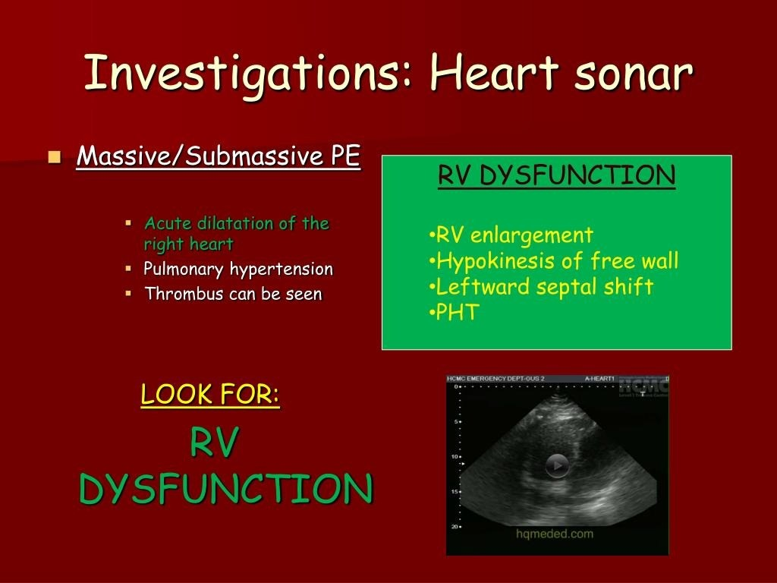

Slide 23
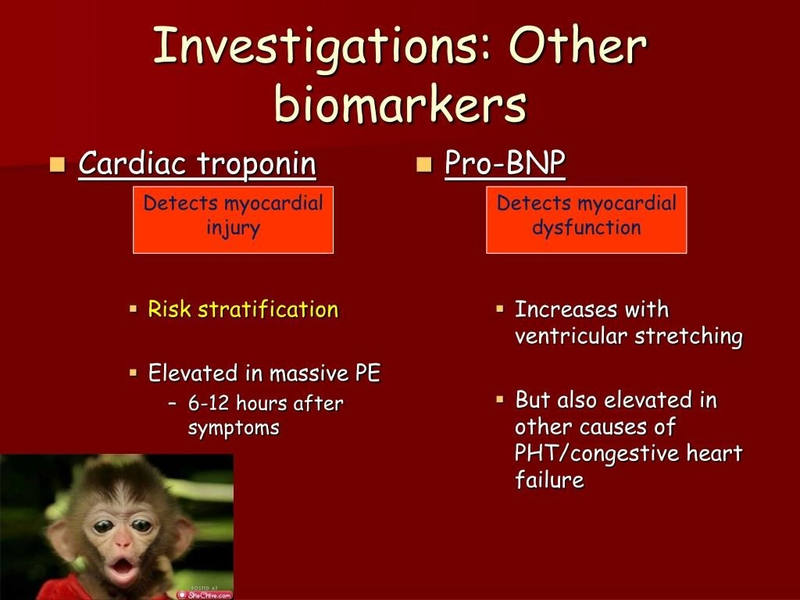

Slide 24
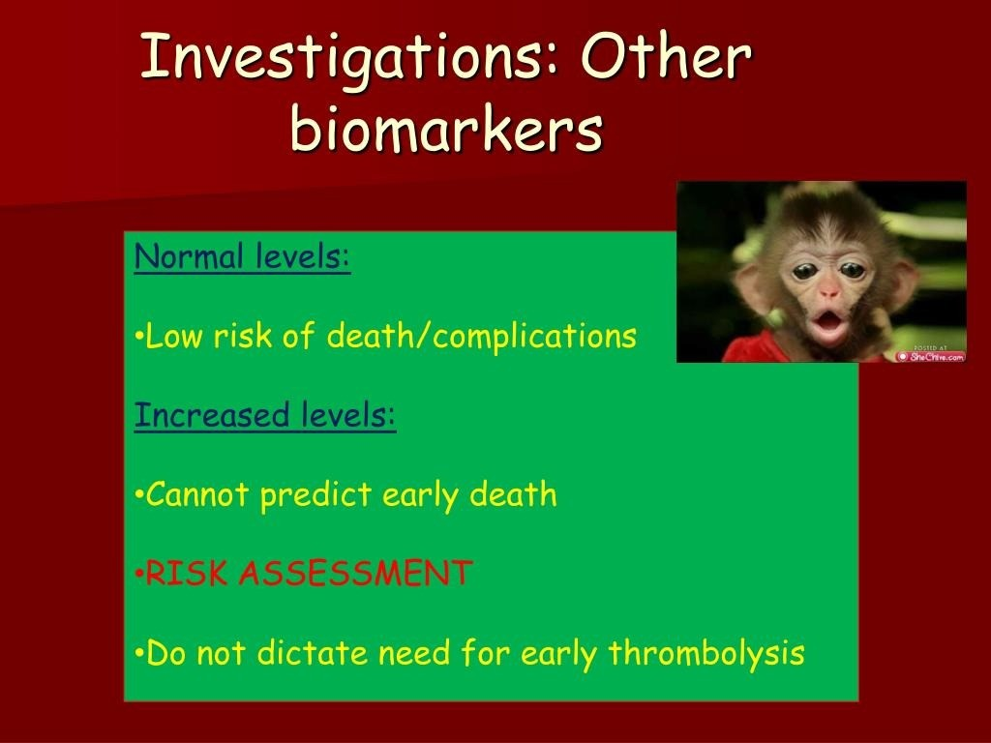

Slide 25
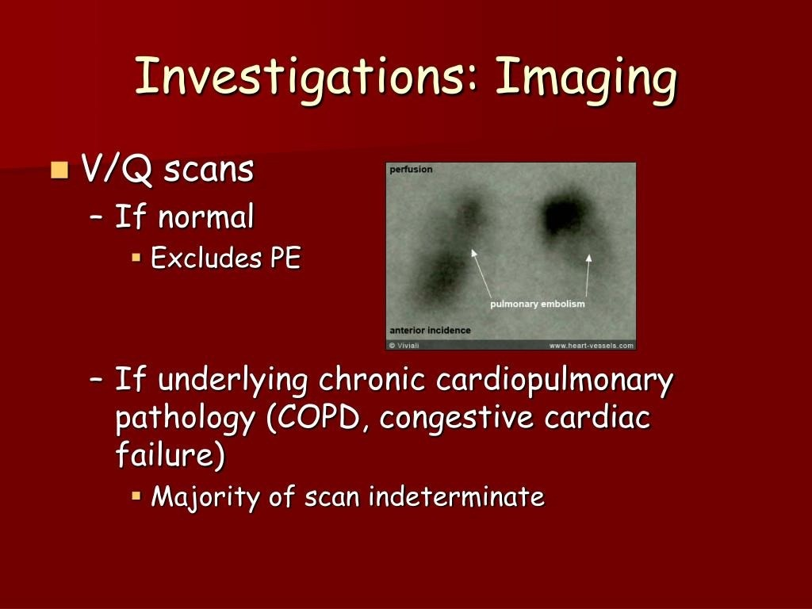

Slide 26
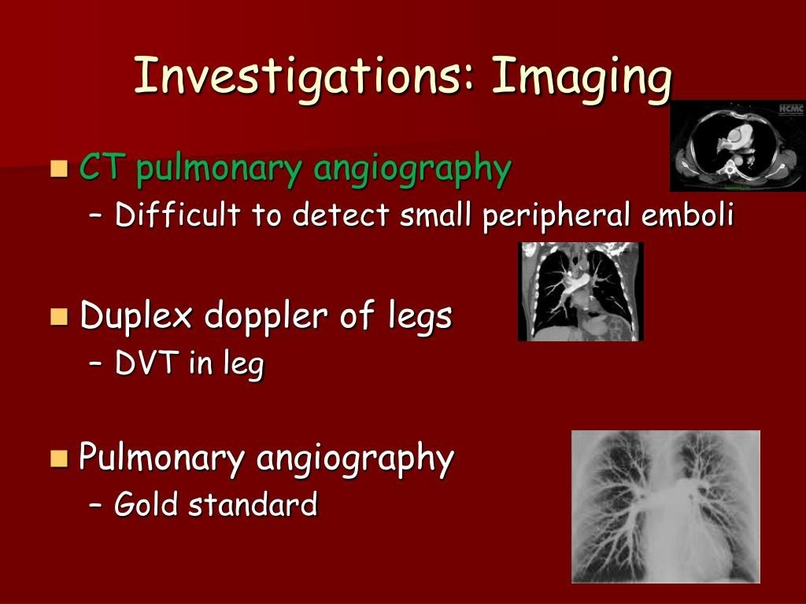

Slide 27
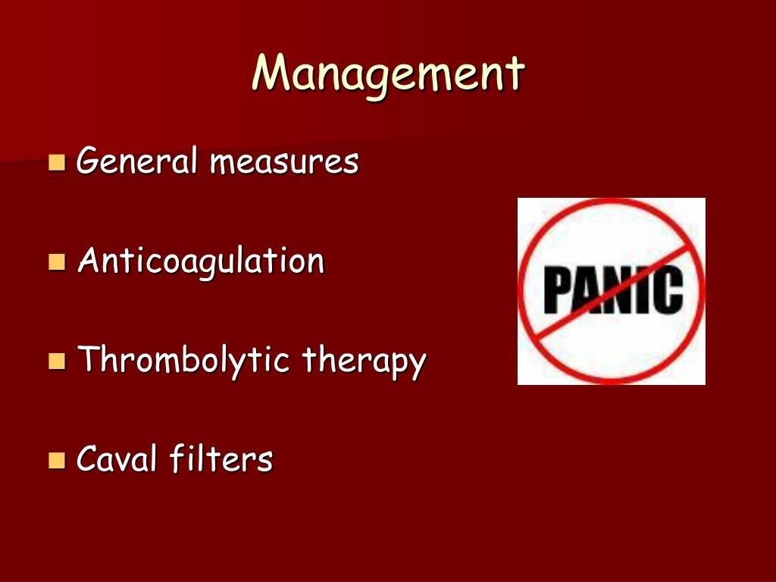

Slide 28
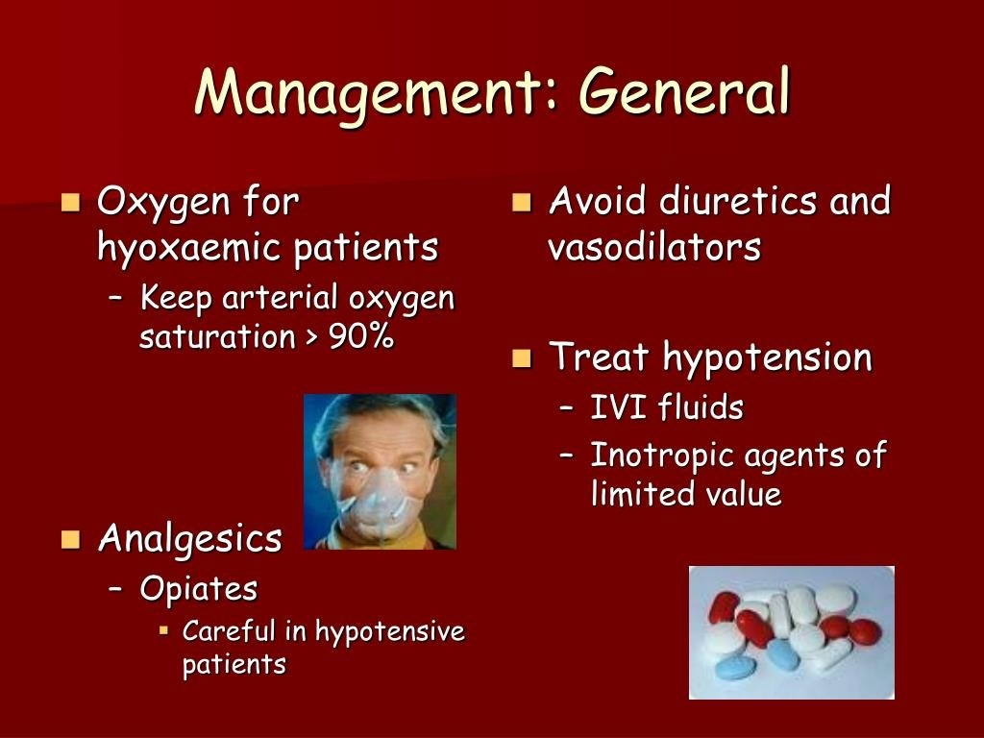

Slide 29
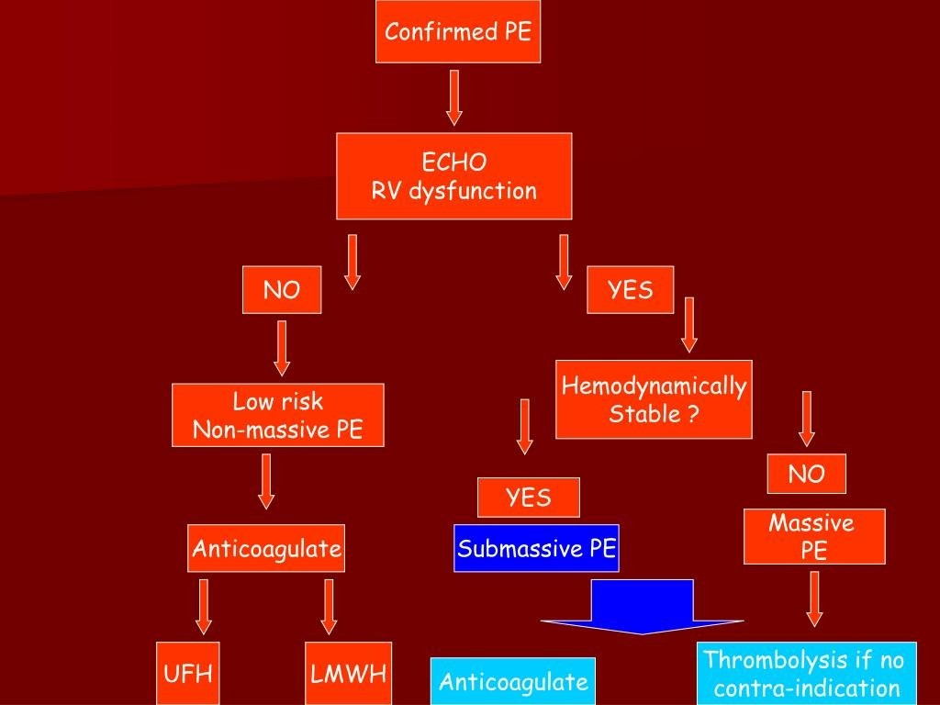

Slide 30
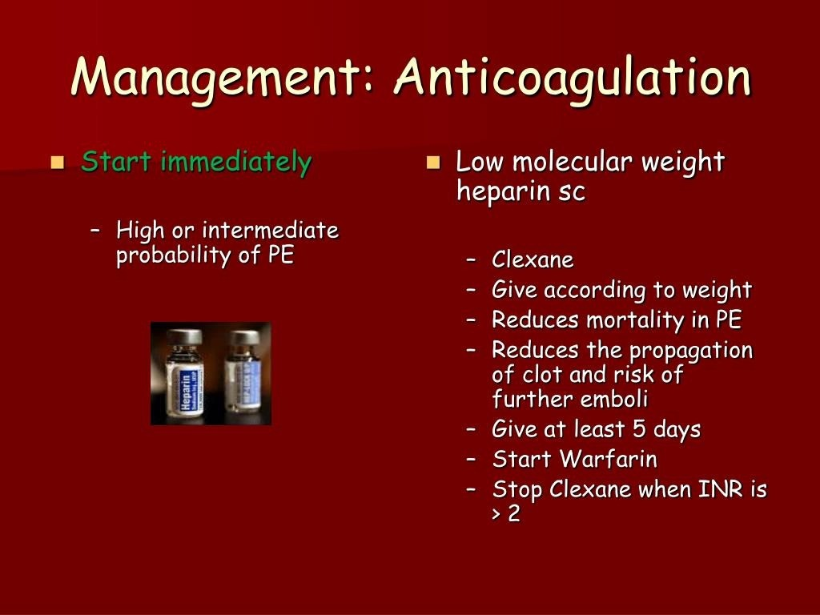

Slide 31
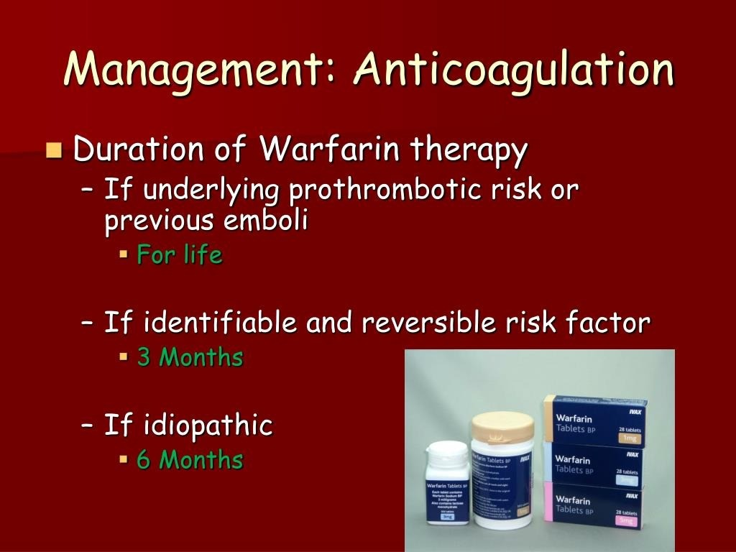

Slide 32
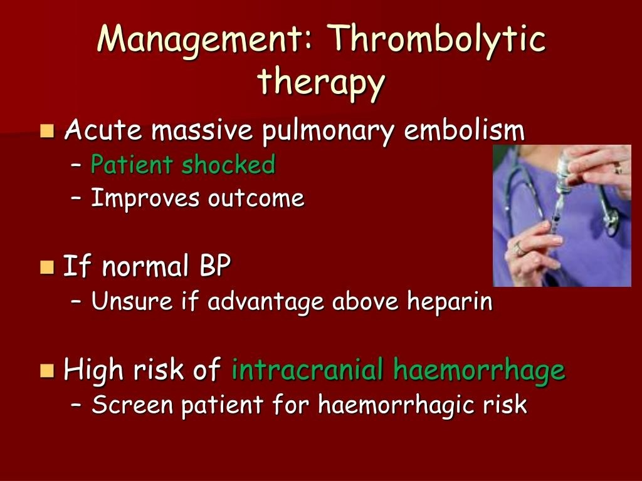

Slide 33
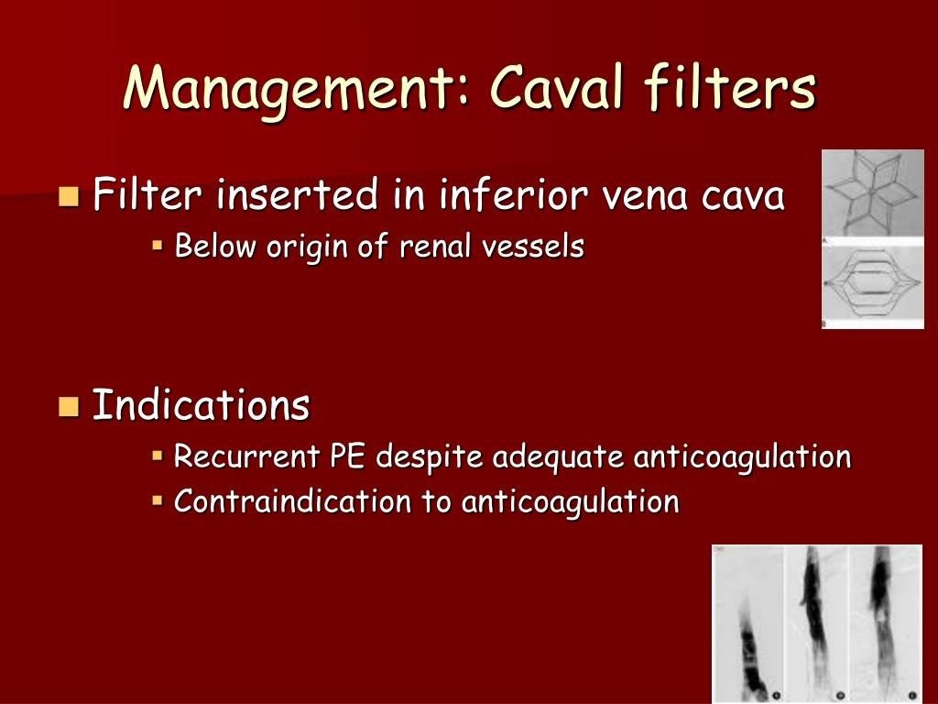

Slide 34
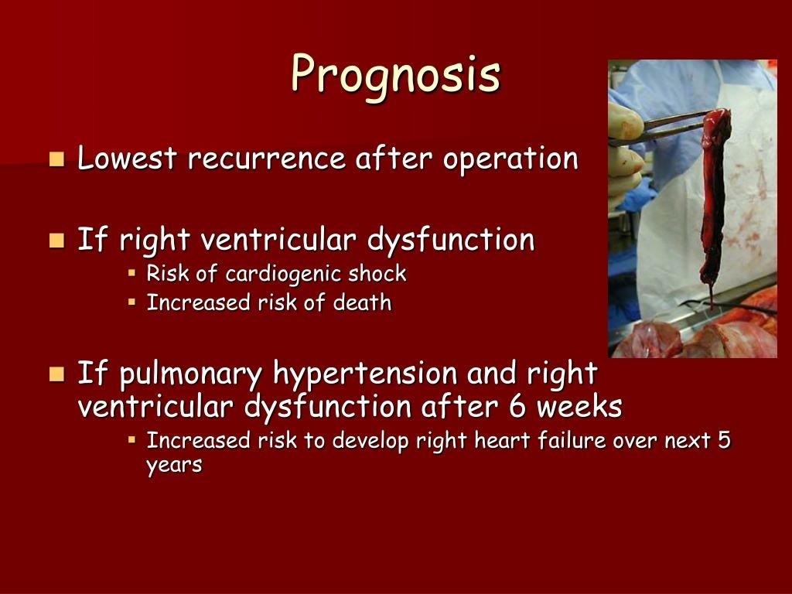

Slide 35
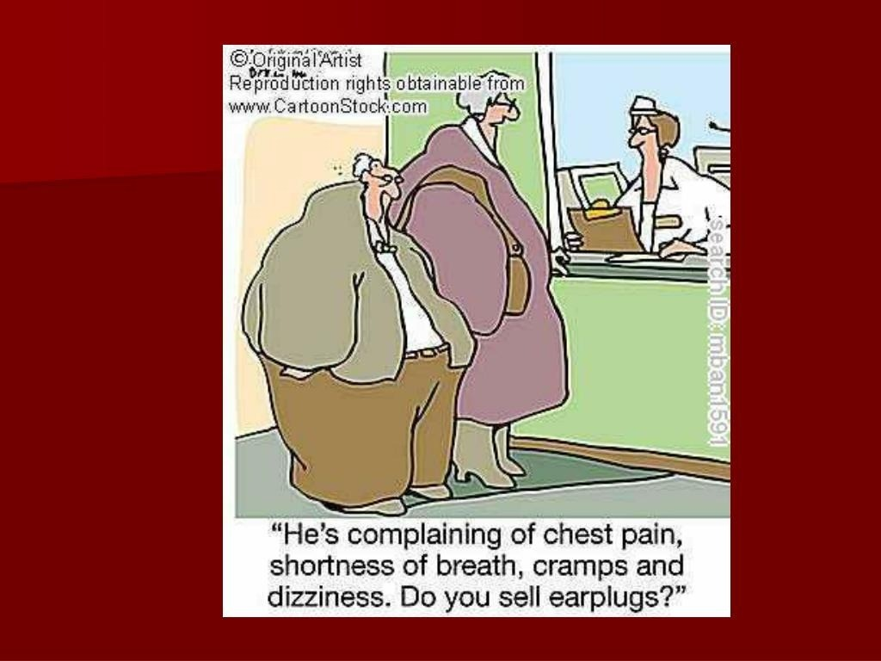

Slide 36


Slide 37
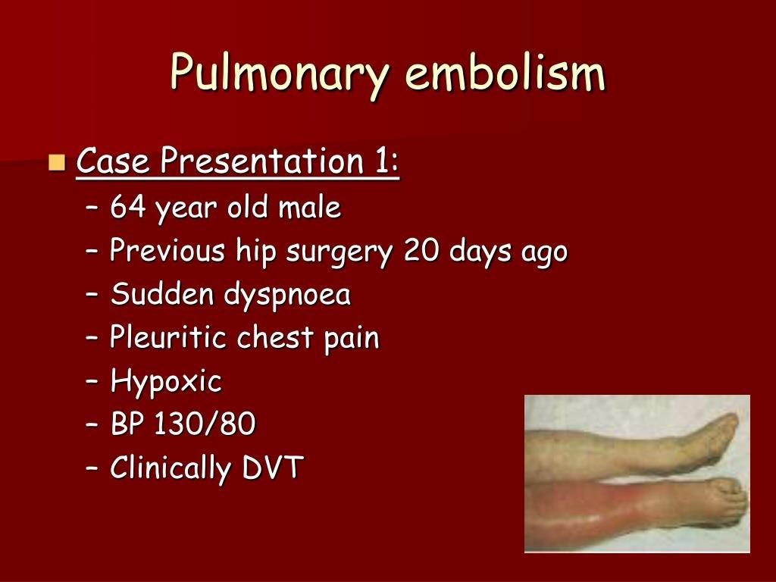

Slide 38
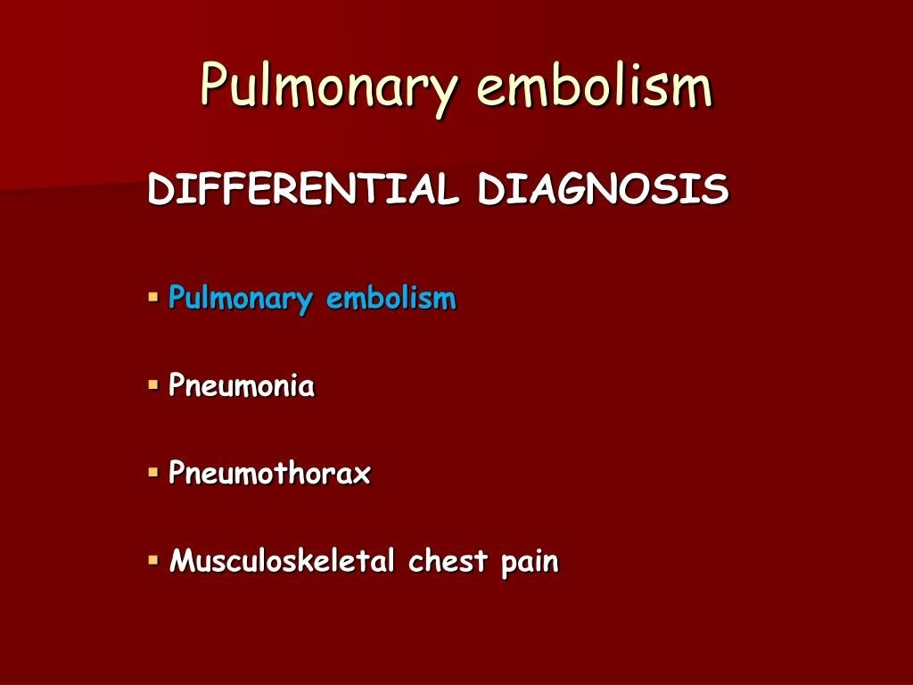

Slide 39
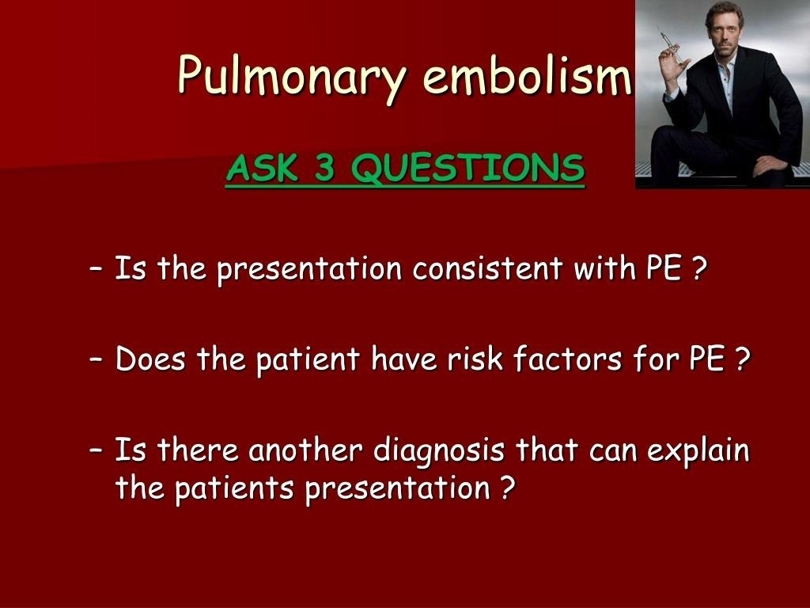

Slide 40
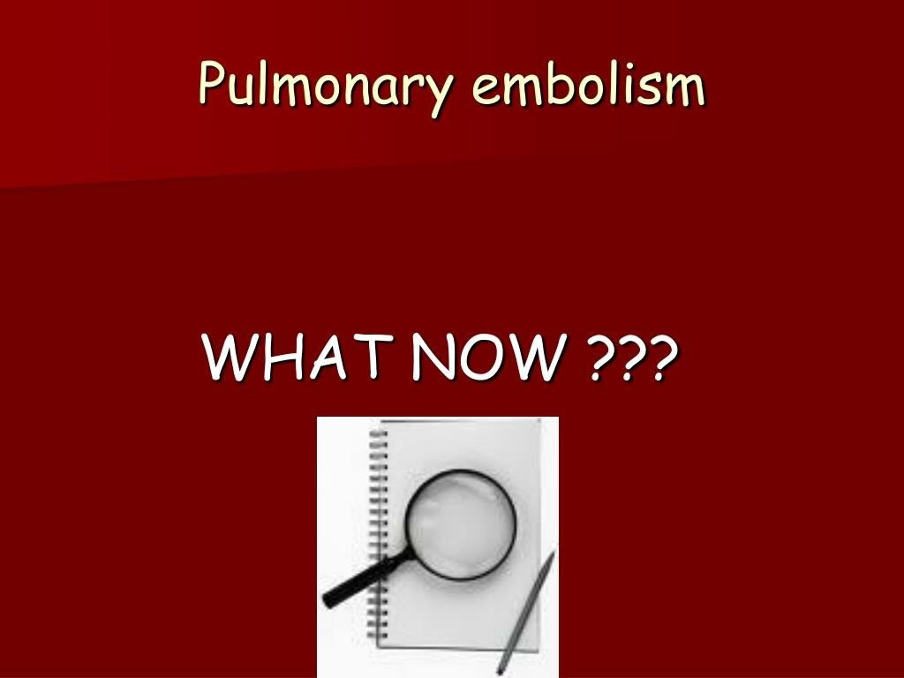

Slide 41
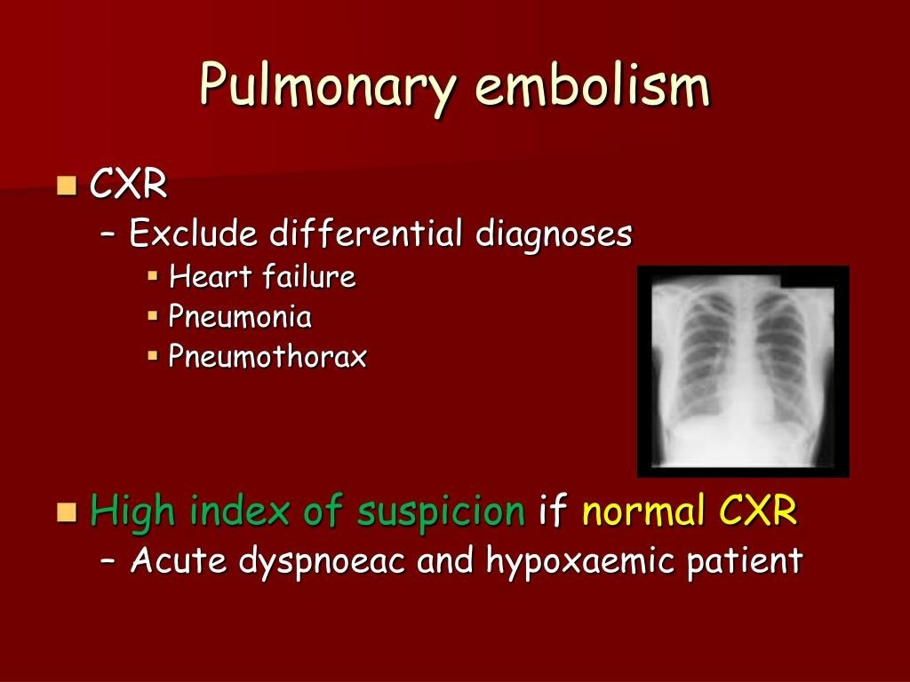

Slide 42
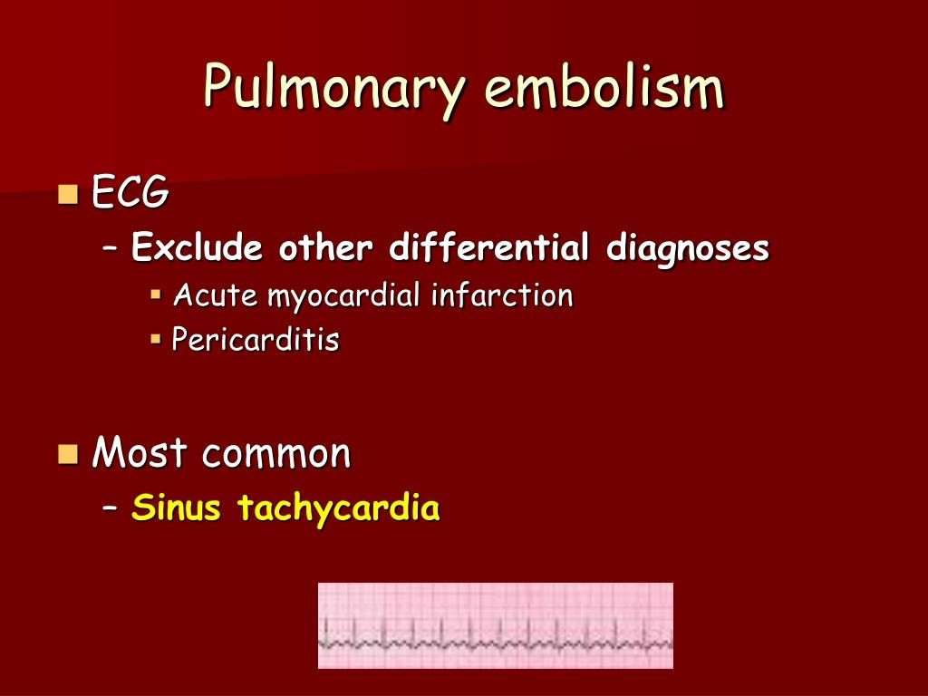

Slide 43
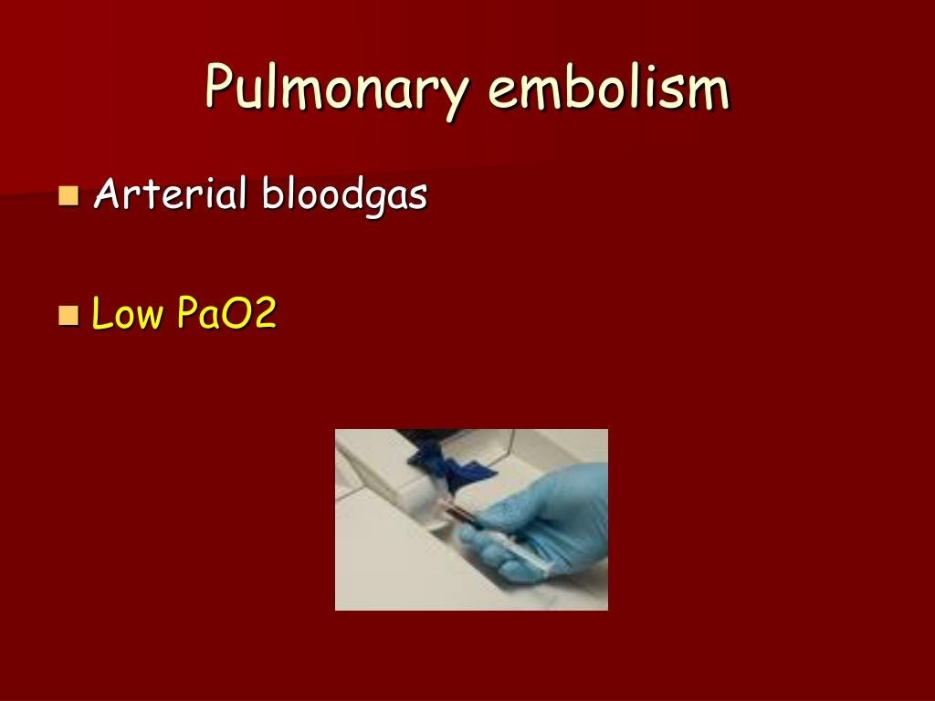

Slide 44
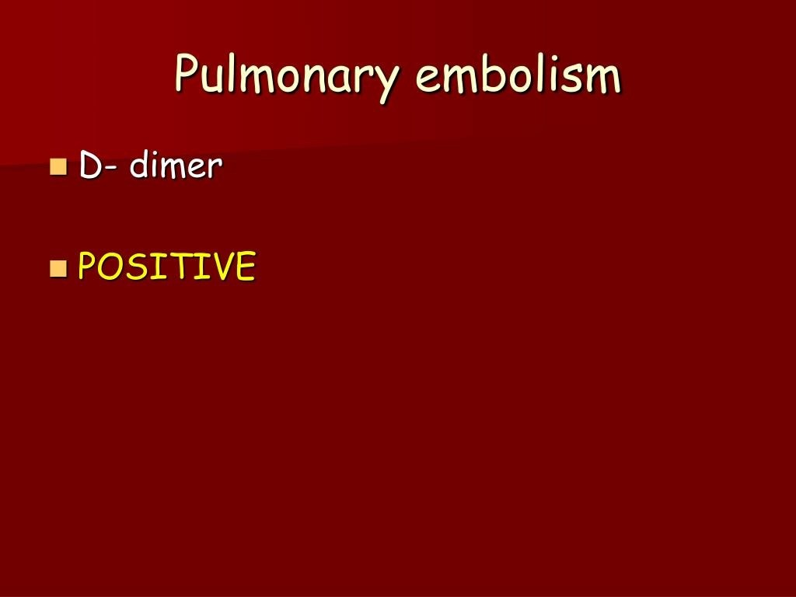

Slide 45
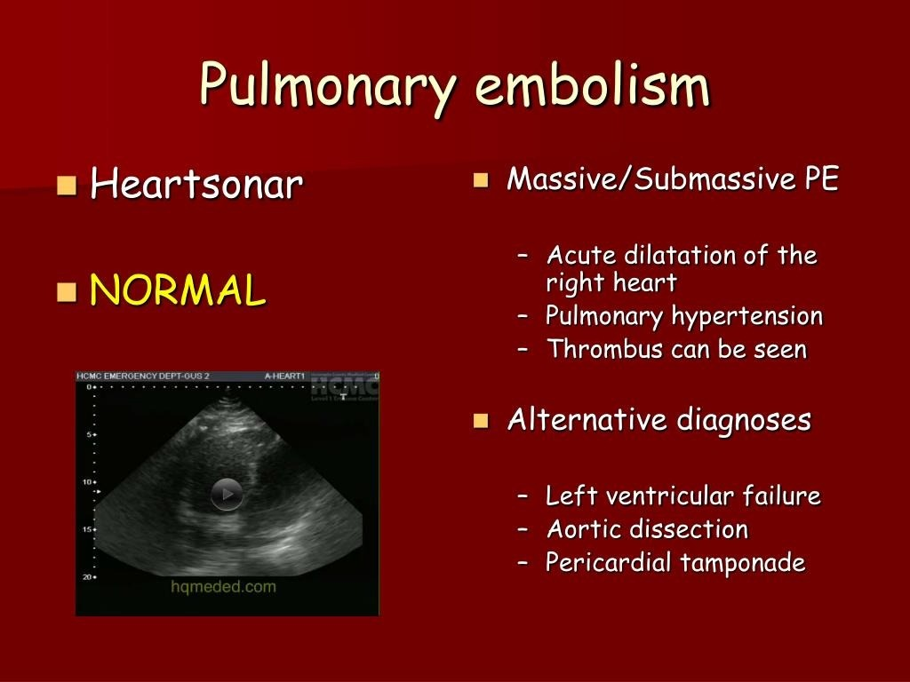

Slide 46
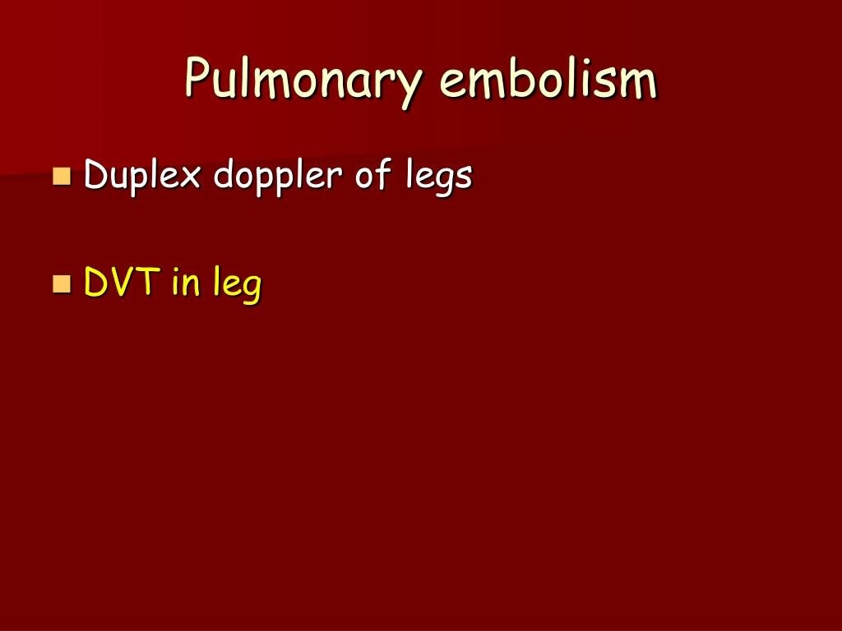

Slide 47
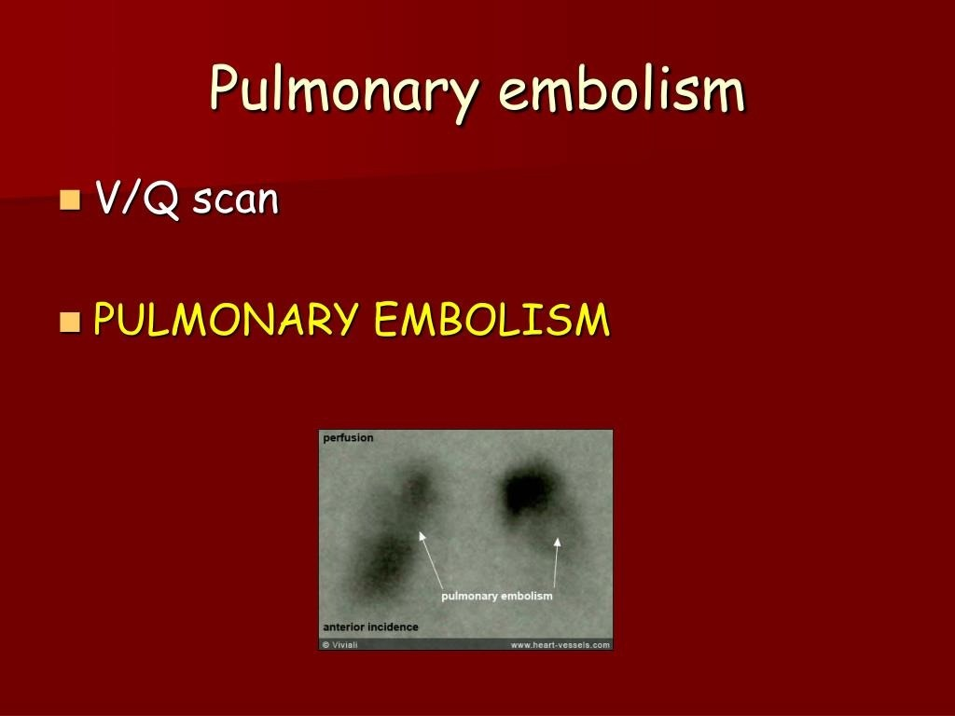

Slide 48
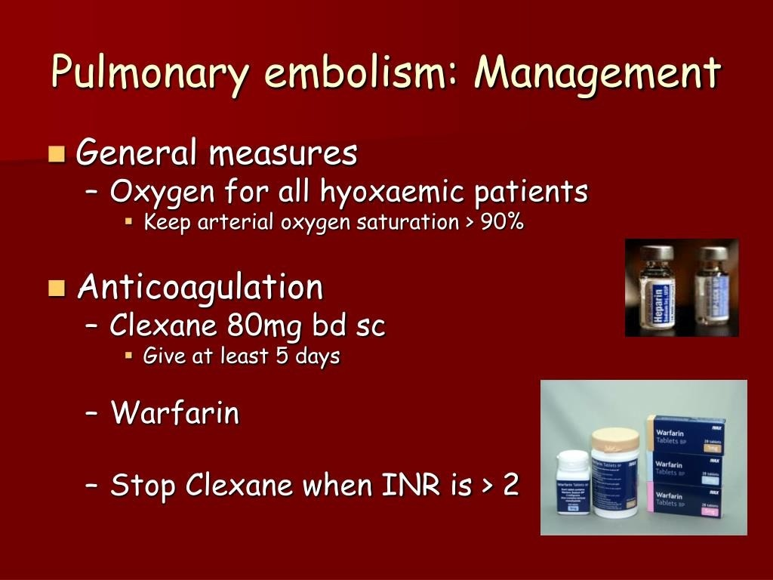

Slide 49
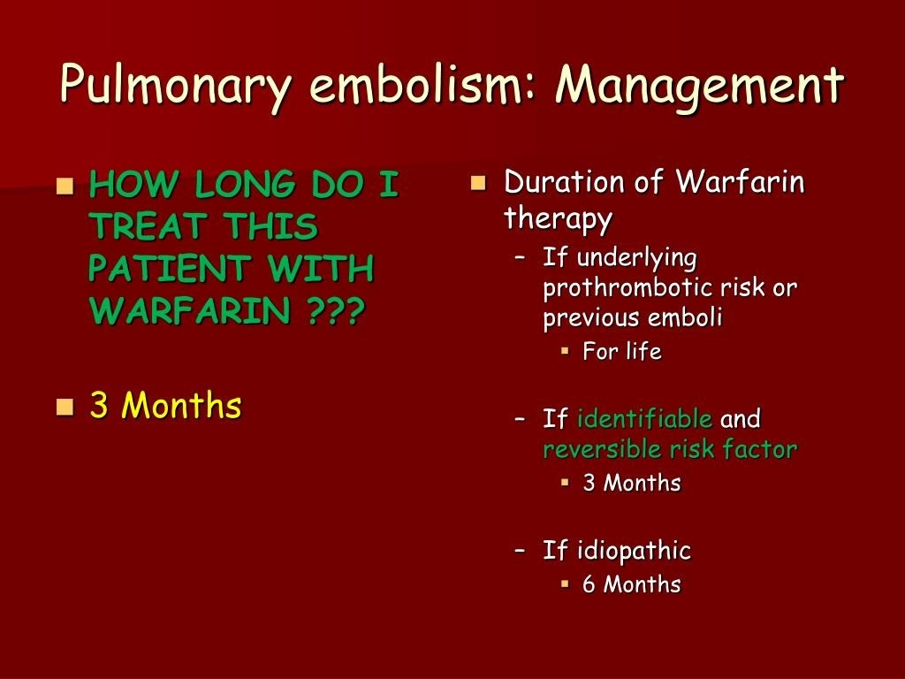

Slide 50
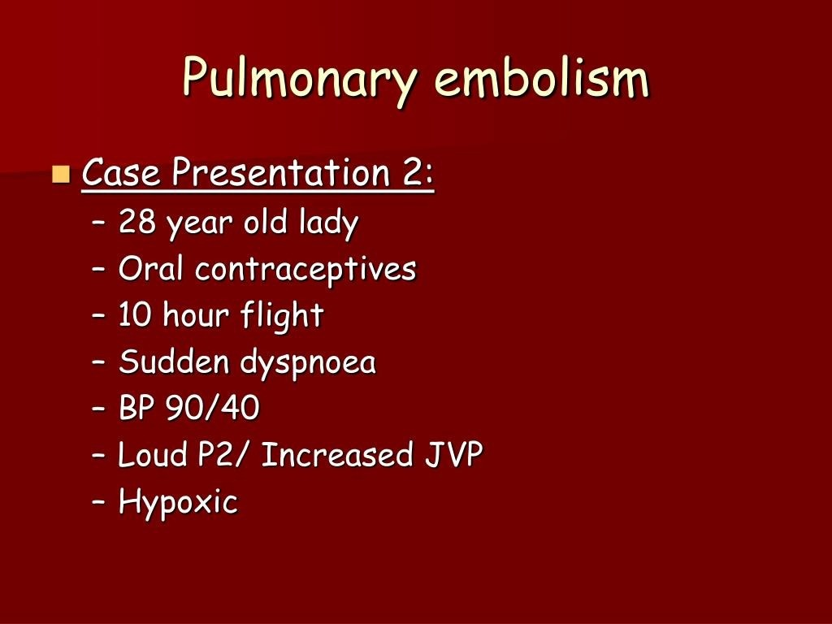

Slide 51
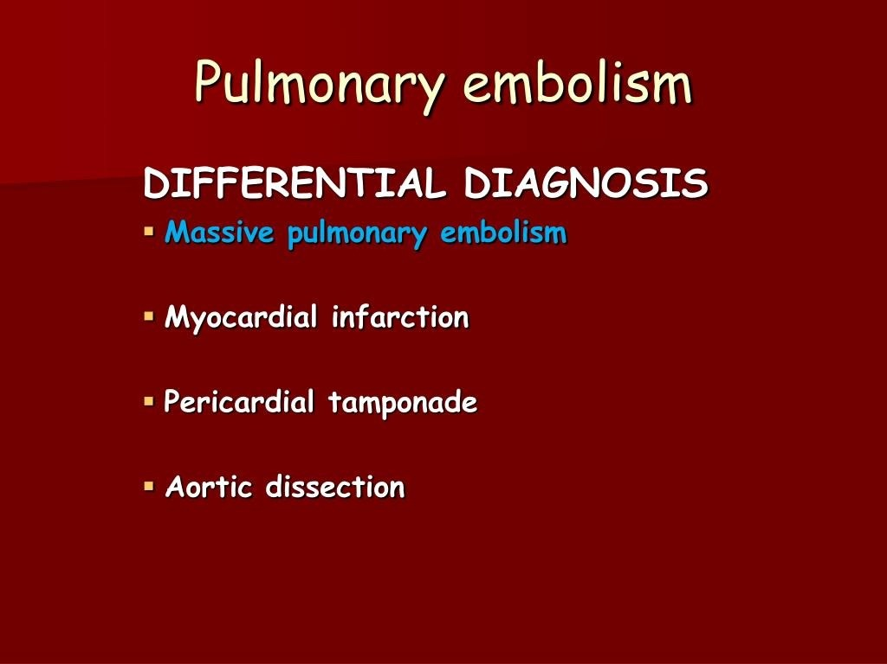

Slide 52
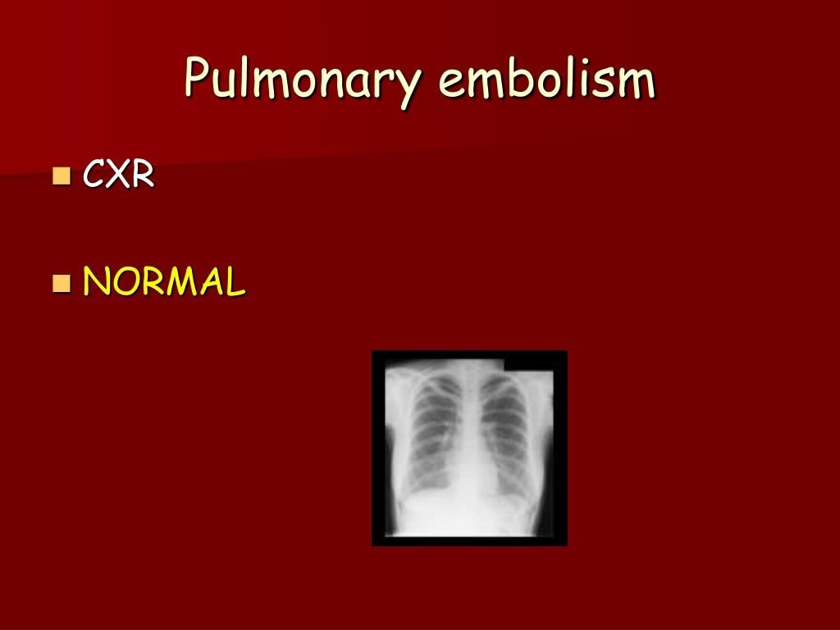

Slide 53
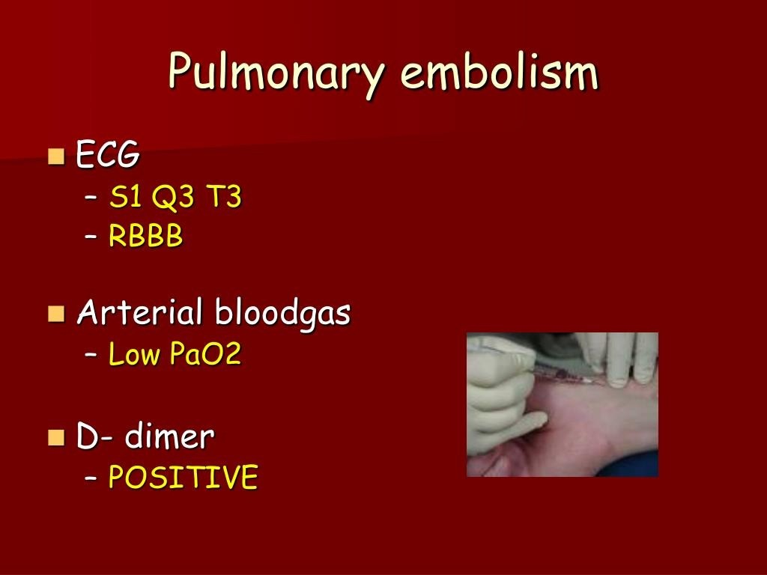

Slide 54
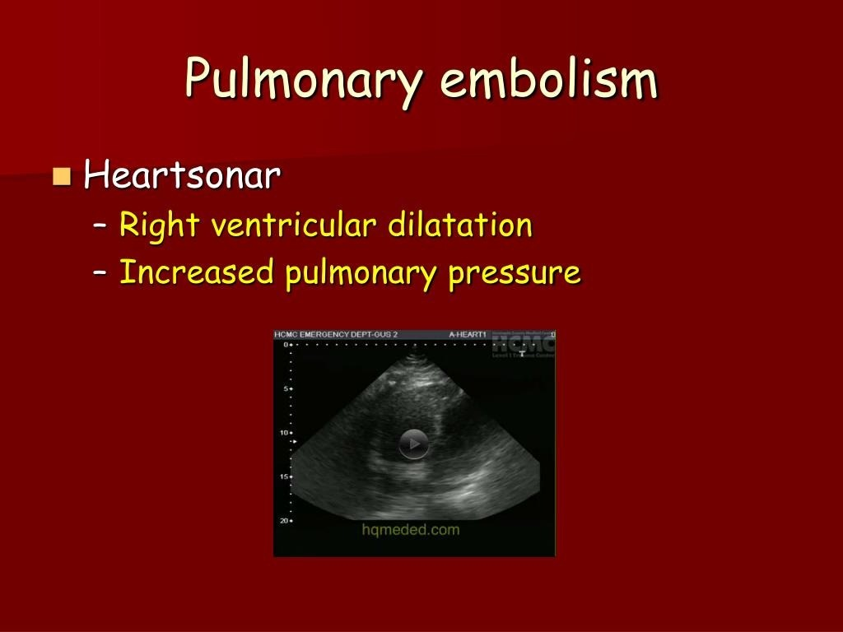

Slide 55
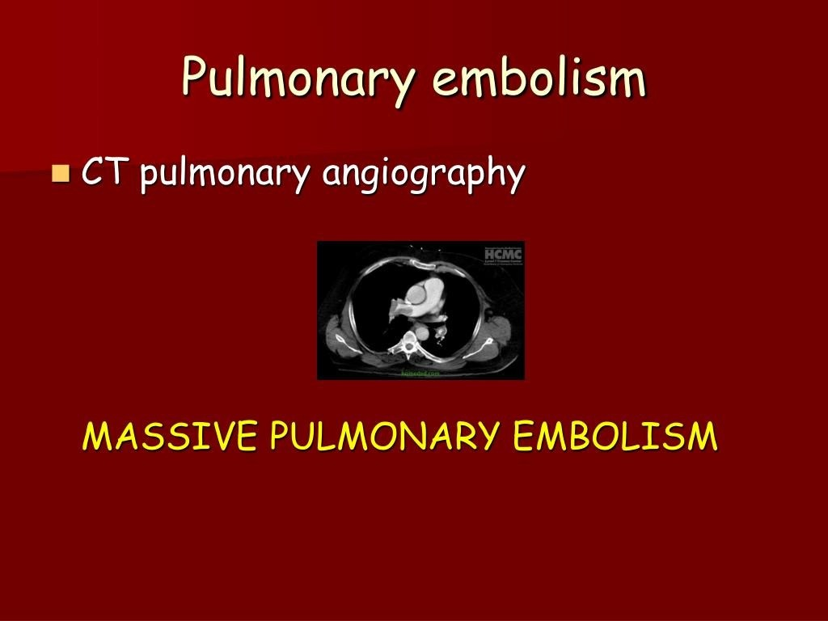

Slide 56


Slide 57


Slide 58


Slide 61


Slide 62


Slide 63


Slide 65


Slide 66


Slide 67


Slide 68


Slide 69
REFERENCES
DAVIDSON’S PRINCIPLES AND PRACTICE OF MEDICINE; 23rd edition
HARRISON’S PRINCIPLE OF INTERNAL MEDICINE; 21ST edition
TEXTBOOK OF CLINICAL MEDICINE by S.N Chugh ;5th edition

Slide 70
QUESTIONS AND ANSWERS

Slide 71
THANK YOU.....

